Slide 1

Hexagon Unified CAD & RMS Replacement Project Update
August 2024

Slide 2
Background
Exploration & Consultant RFQ
RFP Process
Regionalization Workgroup
Governance & Agreement

Slide 3
Governance Boards
Manager’s Board
Oversight
Budget Approval
Conflict Resolution
Executive Board
Support
Operational Guidelines
Budget Development
Change Advisory Board
Change Management

Slide 4

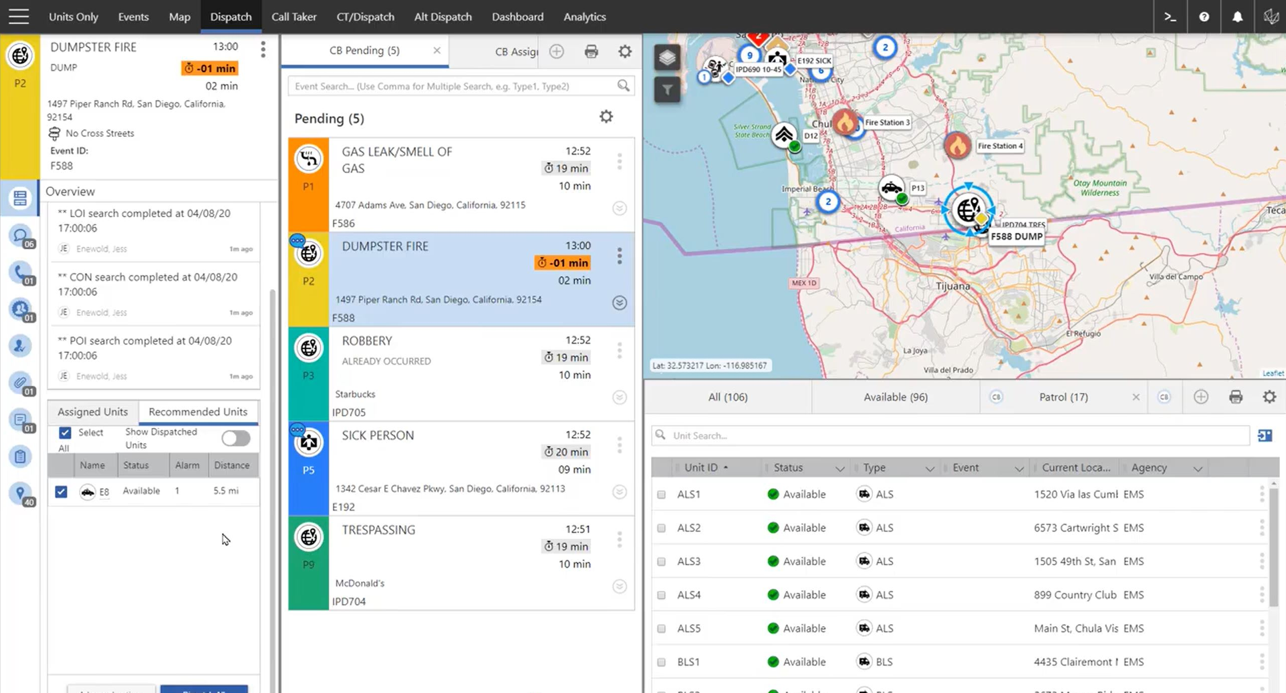
On Call Dispatch
&
On Call Records

Slide 5
Key Accomplishments
Hardware & Software Installation Complete
Initial System Build Complete
Configuration Initiated
3rd Party Integrations in Development

Slide 6
Meeting Regional Goals Through Design
Common Language
Integrated Responses
Automation
Regional Processes
Information Access

Slide 7
Remaining Timeline
Configuration
Testing
Training
Go-Live
Sept ‘24
Jan ‘25
Mar ‘25
July ‘25
Sept ‘25

Slide 8

Project Status
On Schedule
On Budget
Fully Supported
Prepared for Go-Live on 09/09/25

